Slide 1
What's prediction got to do with adaptation?
Dave Kleinschmidt // Princeton Neuroscience Institute
Kavli Summer Institute // 26 June 2017

Slide 2
Adaptation is ubiquitous
In the brain
Less BOLD signal from repeated stimuli
Lower single neuron firing from repeated stimuli
Changes in preferred stimuli based on stimulus ensemble
Smaller ERPs from repeated stimuli
In behavior

Slide 3
What does it Mean??

Slide 4
Computational level
Why should the brain adapt?
What is adaptation?
Goals of the organism
Constraints from the brain (meat computer)
Notes:
want to arm you with a way of approaching this problem. the math really provides a set of conceptual TOOLS. ....and in keeping with the theme of this week (and because it's what I know best) I'm going to focus on speech perception

Slide 5
INFORMATION
‘The cat runs away from the dog’
SIGNAL
Uncertain
Variable
Notes:
...but it's important to keep in mind that the issues I'll talk abou twith speech are really a special case of a very general problem in language comprehension and in cognition as a whole: that you need to make sense out of noisy, variable signals in order to extract meaningful information about the world. what makes this a hard problem?

Slide 6
Likelihood:
p(cue | category)
Posterior:
p(category | cue)
Notes:
EXPLAIN CLASS FUNCTION. but this is okay! as long as we know the cue distribution for each category, we can take any particular cue value, compare how likely it is under either distribution, and convert that into a probability of “sip” or “ship”.

Slide 7
IAF
GGG
[Newman, Clouse, and Burnham, 2001]
Notes:
Speech also demonstrates another important problem for perception: cue distributions vary from one situation to the next. ( EXPLAIN FIGURE ).
If you use the wrong generative model, you’re going to get into trouble.
In general, hard problem. BUT: here’s a thing that is very clear in speech: the variation isn’t completely arbitrary. In this case, it’s conditioned on talker identity. This kind of structure makes dealing with variability much easier.
The other complicating factor is what’s known as the “lack of invariance”, or the fact that the mapping from cues to categories CHANGES depending on who’s talking. Two things to note here. You can see here that there’s a lot of variability bETWEEN talkers, too. This is a particularly extreme case, where IAF’s “sip” is physically indistinguishable from GGG’s “ship” on this cue. This kind of variability means that there’s often quite a bit of uncertainty about what the right generative model is in any given situation, and so you need to be tracking the cue distributions. The other thing to note is that this variability isn’t totally random: it’s conditioned on who is talking. That is, there’s a lot of structure there. I’ll come back to that in a bit.
For now, what matters is that you don’t know the generative model with any certainty, and this basically torpedos the ideal listener: how can you do accurate inference if you don’t know the generative model?

Slide 8
Coping with variation
Listeners rapidly adapt to accented speech
With just a few minutes of exposure, comprehension gets much better [Clarke and Garrett, 2004]
How do people adjust category boundaries so fast?
Notes:
two examples of

Slide 9
Distributional learning!!

Slide 10
Distributional learning
Try to reduce prediction error for the data you've seen
Makes your predictions better in the future
...and inferences more accurate
Notes:
let's look at hwo this works in a few cases

Slide 11
distributional learning for
ambiguous /b/
/b/
/d/
low probability =
high prediction error
higher probability =
lower prediction error
Notes:
(focus on prediction error here

Slide 12
distributional learning for
prototypical /b/
high probability =
still some prediction error!
higher probability =
lower prediction error
Notes:
[ qualitative predictions: negative aftereffect ]

Slide 13

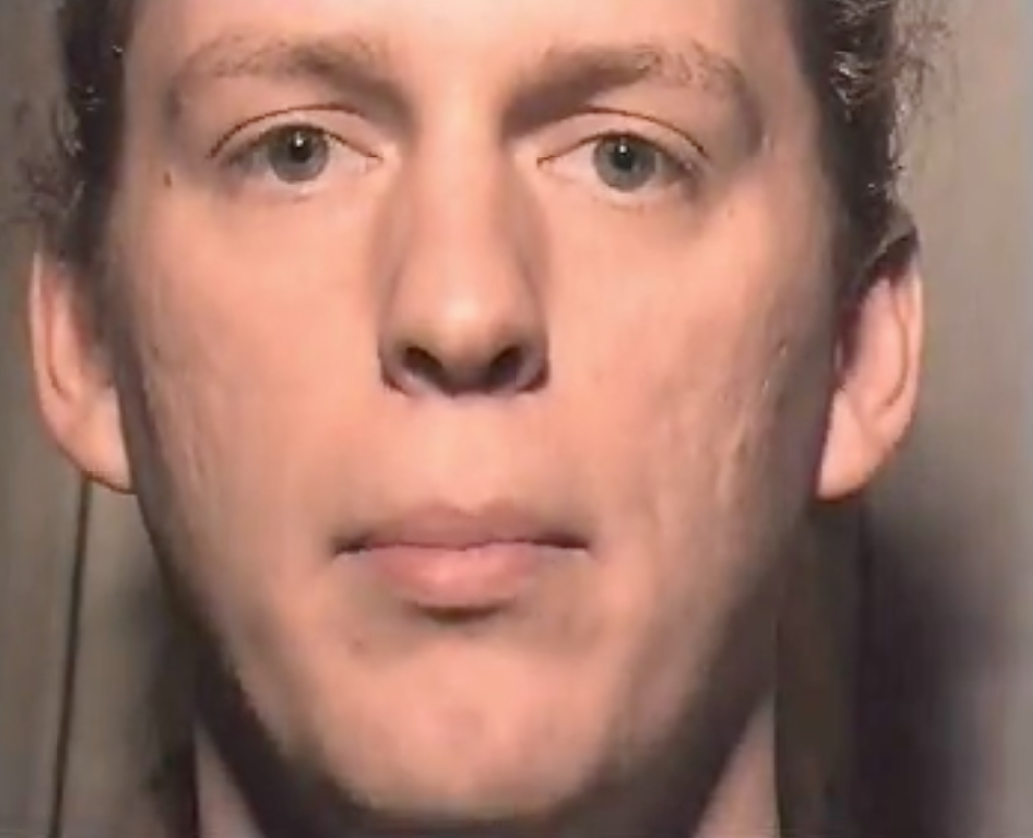
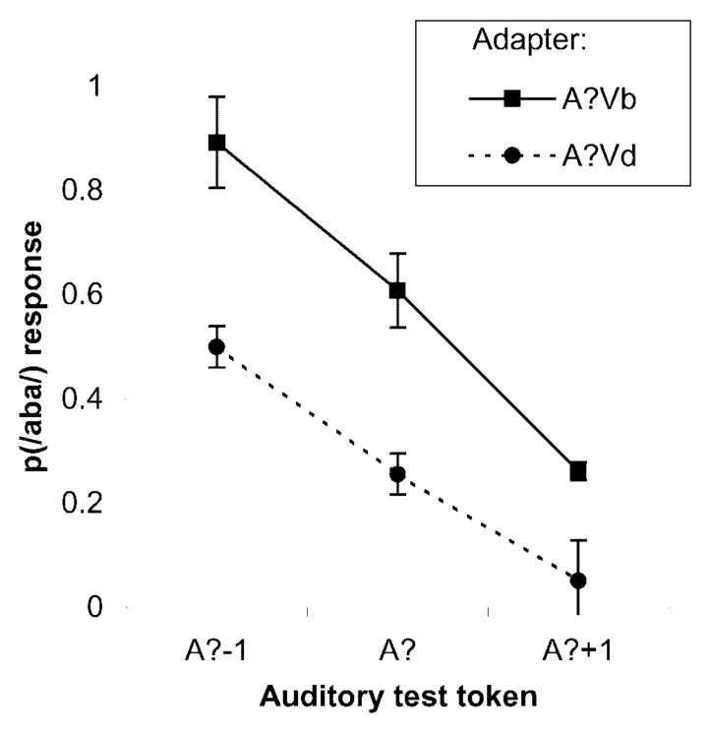
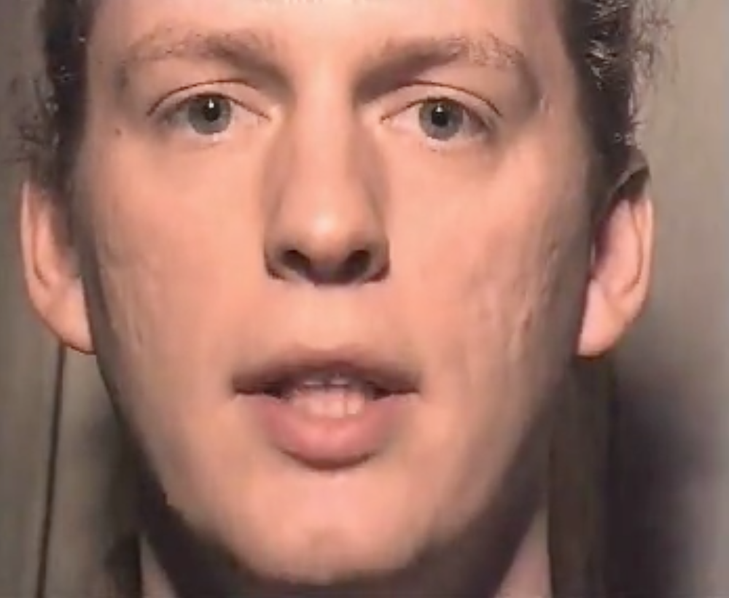

Recalibration
Ambiguous cue
+
Visual Label
= Boundary shift
Vb
A?
/b/
/d/
/aba/ to /ada/
acoustic continuum
Vd
Notes:
(( could cut this slide ))

Slide 14
Model results [Data: Vroomen et al. 2007; Model: Kleinschmidt & Jaeger 2015]
r² = 0.93
Notes:
Fit them together very well. Two things to note: one of these is recalibration one is selective adaptation, typically thought to be very different mechanisms (learning vs. neural fatigue). also decay in recalibration has puzzled people. but it just falls out of belief updating.
R^2 = 0.93 overall and 0.85 for each individually

Slide 15
But what is distributional learning?

Slide 16

It’s all inference under uncertainty

Slide 17
But what is distributional learning?
Infer categories and generative model
(e.g. category means/variances)
posterior (updated)
beliefs
likelihood
prior beliefs
Notes:
these equations can look intimidating but really they're not so scary.

Slide 18
Hypotheses
(prior)
probability
high
low
Data
Notes:
Just to give you a sense of how this works,

Slide 19
Hypotheses
(prior)
probability
high
low
Data

Slide 20
(prior)
probability
high
low

Slide 21
Hypotheses
(prior)
probability
high
low
Data

Slide 22
Hypotheses
(updated)
probability
high
low
Data

Slide 23
Hypotheses
(updated)
probability
high
low
Data

Slide 24
Hypotheses
(updated)
probability
high
low
Data

Slide 25
Hypotheses
(updated)
probability
high
low
Data

Slide 26
Hypotheses
(updated)
probability
high
low
Data

Slide 27
Hypotheses
(updated)
probability
high
low
Data

Slide 28
Hypotheses
(updated)
probability
high
low
Data

Slide 29
Where do you get the prior?

Slide 30
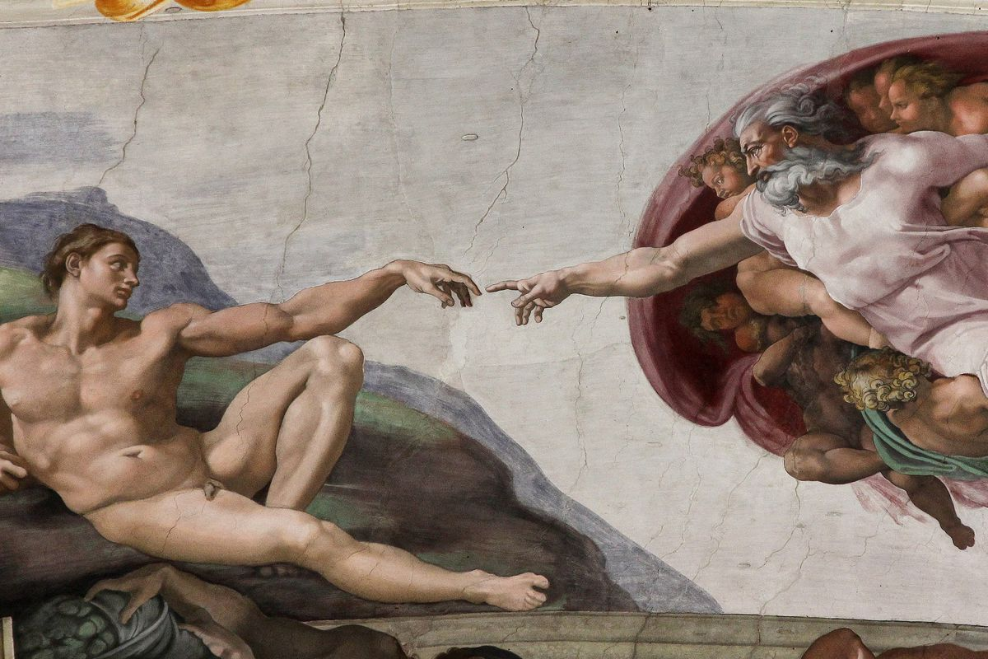
Distributional learning!!

Slide 31
Where do you get the prior?
Prior is a prediction
Utility of prediction depends on distribution of things in the world
Predict things you never get: inefficient (takes longer to adapt)
Rule out things you do get: can't adapt
Good prior depends on learning those distributions (of distributions)

Slide 32
Observations
Prior experience
*
Notes:
each talker's generative model is a point in "generative model space". you can think of this as a space where ach dimension is a parameter of the generative model. Now, distribtuion in this space is a _prediction_ about what kind of distributions you expect to encounter. let's take a step back and think about what kinds of predictions we'd make, as omniscient oracles

Slide 33
Notes:
in the absence of any particular expectations...
when you go into a situation where you’re ready for weird stuff to happen, like a phonetics experiment, you should consider basically any kind of generative model that’s at all reasonable. this way you be maximally flexible and make the best use of the data you get.

Slide 34
Notes:
each situation calls for a different set of prior beliefs: if you know you're going to encounter a familiar talker, your prior beliefs should reflect your previous experience with them.

Slide 35
Notes:
…Or, if you know you're talking to a female, you can use your experience with other female talkers, and teh range of generative models they use, to narrow down the range of generative models you consider

Slide 36
How relevant is prior experience right now?
Not very
Adapt
Kinda
Generalize
Totally relevant
Recognize
Notes:
what this means is that, your predictions (and hence prior) should be conditional on the type of talker. if this is right, the brain doesn’t just keep one generative model around that it constantly tunes (unlike all other models of adaptation). Rather, you’re doing two things: first, they have to be inferring what prior experience is relevant in each situation (type of talker is part of posterior). second, they have to be distributional learning all these different distributions for different types of talkers as they go. this is akin to the sort of thing that people have proposed for phonetic category learning, but instead of learning distributions of cues, I’m suggesting that listeners should be learning distributions of generative models.

Slide 37
How relevant is prior experience right now?
Not very
Adapt
Kinda
Generalize
Totally relevant
Recognize
Talker-specificity
[e.g. Goldinger; Nygaard; Pisoni; Sumner; many others]
Persistent adaptation
[Eisner & McQueen, 2006; Kraljic & Samuel 2005]
Notes:
for the rest of the talk, rather than present further models, I'm going to show you how to reason through this and what the predictions this framework makes. First off, lots of evidence for learning and using talker-specific beliefs, way more than I have time to go into.

Slide 38
How relevant is prior experience right now?
Not very
Adapt
Totally relevant
Recognize
Kinda
Generalize
Top down cues (gender, dialect, accent)
[e.g. Hay & Drager, 2010; B. Munson 2011, Niedzielski, 1999;
Staum Casasanto, 2008; Strand & Johnson, 1996]
Accent adaptation
[Bradlow & Bent, 2008; Baese-Berk et al. 2013]
Generalization of recalibration
[Kraljic & Samuel 2005, 2007; C. Munson, 2011; Reinisch & Holt, 2013]
Notes:
I'm gonna give you [two] examples where prior beliefs and observations interact in interesting ways: one focusing on learning distributions of generative model, and the other on inferring which kind of prior beliefs are relevant.
------------------------
from our perspective, the really interesting stuff happens when it’s not totally clear how relevant your prior experience is. listener has to infer, combining bottom-up and top-down cues to who the talker is. There are really only a handful of these kinds of studies that have been done, and they’re seen as kind of curiosities. For the rest of the talk I want to walk you through two case studies of how the ideal adapter approach provides some insight and can drive future work

Slide 39
How relevant is prior experience right now?
Not very
Adapt
Kinda
Generalize
Totally relevant
Recognize
Perceptual learning/Recalibration
[e.g., Bertelson et al. 2003; Norris et al. 2003; Maye, Aslin, & Tanenhaus, 2008]
Selective adaptation*
[e.g., Eimas and Corbit, 1973; Samuel 1986]
Language-level prior
[e.g., Idemaru & Holt, 2011; Schertz et al., 2016; Kleinschmidt & Jaeger, submitted]
Notes:
…but first, I want to go through an example of how prior experience matters EVEN WHEN YOU’RE RAPIDLY ADAPTING.
------------------------
from our perspective, the really interesting stuff happens when it’s not totally clear how relevant your prior experience is. listener has to infer, combining bottom-up and top-down cues to who the talker is. There are really only a handful of these kinds of studies that have been done, and they’re seen as kind of curiosities. For the rest of the talk I want to walk you through two case studies of how the ideal adapter approach provides some insight and can drive future work

Slide 40
Prior beliefs constrain adaptation
Expose to different accents (n = 138 on MTurk):
“beach”
“peach”
[Based on Clayards et al. 2008; Kleinschmidt & Jaeger, CogSci2016]
Notes:
ongoing work that even when you’re rapidly adapting to a new talker, prior experience matters
prediction is this: if you encounter a talker whose accent is way outside the normal range of variation, your prior is going to be hard to overcome.
to test this, …
before I move on, briefly mention some ongoing work about the role that your prior beliefs play. prediction: accelerate adaptation to talkers when they line up with prior beliefs, but constrain adaptation to talkers that fall outside.
each accent differs just in the distribution of voice onset time, an important cue in distinguishing words like “beach” and “peach”. we know that people pick up on this distributional information, and learn that the lower cluster corresponds to words like “beach” and the higher one to words like “peach”.
…can use this to actually infer what peoples prior beliefs are. this is just two categories, and one cue, but we can scale it up pretty easily with crowdsourced data.

Slide 41
Prior beliefs constrain adaptation
Predict classification curves
…and compare with behavior
[Based on Clayards et al. 2008; Kleinschmidt & Jaeger, CogSci2016]
Notes:
and based on these distributions, we can predict what the optimal classification function would be. you can see that some of these distributions differ quite a bit from what a typical talker produces. we asked people to say whether they heard “beach” or “peach” on each trial, and compared their responses to the ideal classification curves. You can see that their category boundaries are all pretty much in between what the predictions for perfect learning, and for a typical talker.
…can use this to actually infer what peoples prior beliefs are. this is just two categories, and one cue, but we can scale it up pretty easily with crowdsourced data.

Slide 42
Adaptation tells us something about prior beliefs
Fit “inverted belief updating” model
Prior beliefs are unknown, inferred from adaptation data
Notes:
one of the consequences of this is that, to the extent that adaptation is constrained by listeners prior beliefs, their adaptation behavior tells us something about those subjective prior beliefs about cross-talker variability.
Formalize this with a belief updating model where listeners start from some common set of prior beliefs which we treat as free parameters, and fit to the adaptation data from these different conditions.
We find that, first, the model actually fits behavior really well. Second, it predicts adaptation in totally different exposure conditions. Third, and finally, the prior beliefs the model infers look more or less like the actual pattern of variability across talkers.

Slide 43
Inferred prior beliefs predict adaptation to new distributions
Predict adaptation from prior beliefs
…and compare
Expose to new distributions (n = 119 on MTurk):
Notes:
one of the consequences of this is that, to the extent that adaptation is constrained by listeners prior beliefs, their adaptation behavior tells us something about those subjective prior beliefs about cross-talker variability.
Formalize this with a belief updating model where listeners start from some common set of prior beliefs which we treat as free parameters, and fit to the adaptation data from these different conditions.
We find that, first, the model actually fits behavior really well. Second, it predicts adaptation in totally different exposure conditions. Third, and finally, the prior beliefs the model infers look more or less like the actual pattern of variability across talkers.

Slide 44
How does the brain do this?

Slide 45
We have no idea!!
Notes:
this is presumably why you are here: because this is an area where there's a lot of very interesting work just begging to be done.

Slide 46
How does the brain do this?
Predictive coding in posterior STS [Blank & Davis, 2016 PLoS biology]
Neural correlates of recalibration in frontal, temporal, and parietal areas [Kilian Hutten et al. 2011; Myers & Mesite, 2014]
Notes:
A couple of clues: top down influences reach pretty far down in processing

Slide 47
Open questions: adaptation
How does the brain learn new models?
...store, retrieve, and update existing models?
...learn, represent, and deploy knowledge about the structure of variation (in e.g. groups of talkers)?
Notes:
A couple of clues: top down influences reach pretty far down in processing

Slide 48
Learning new models
What is the locus of updated beliefs?
Low level representation of sounds
Higher level categorical read out

Slide 49
1. Expose each subject to one of two accents
/b/
/p/
Low VOT
n = 10 subjects
[bp]_{VOT}each
/b/
/p/
High VOT
n = 10 subjects
0ms
VOT
20
40
60
Notes:
if you get this in put and you’re distributionally learning, there’s two things that will happen.
First: you should be more likely to say that this 20ms stimulus is a /p/.
If you get this low VOT input, somewhere the neural representation of 20ms will shift towards 40ms
On the other hand, if you get this high VOT input, the representation of the exact same physical stimulus will shift towards the 0ms

Slide 50
1½. Verify distributional learning behaviorally
Notes:
I first just want to show you that people do learn : listeners in the low-VOT condition have a lower category boundary between /b/ and /p/. This is important because if they didn’t, there’d be no reason to look for differences in neural representations.

Slide 51
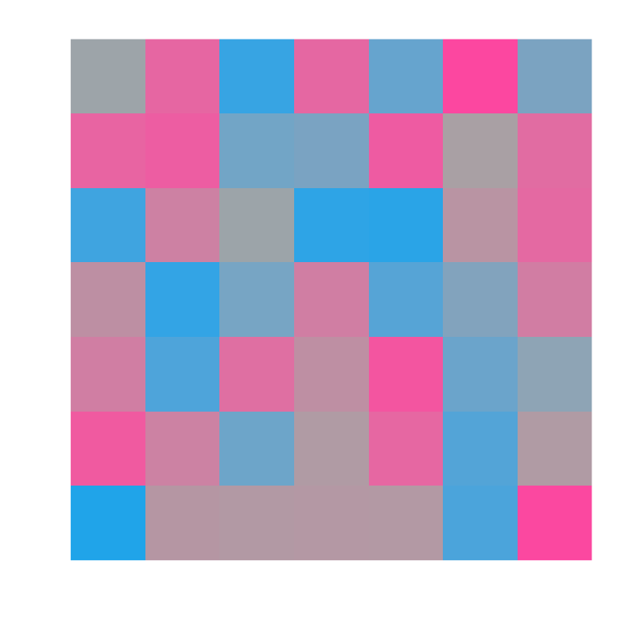
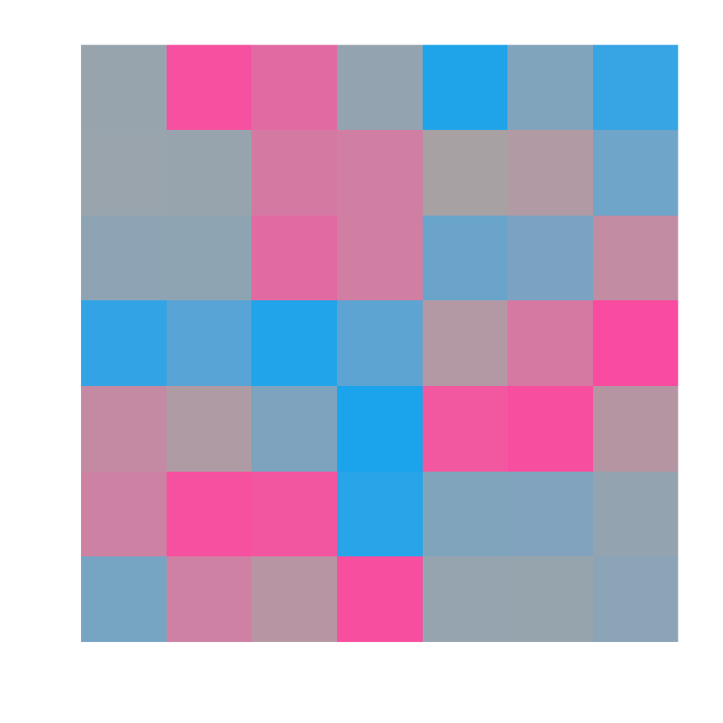
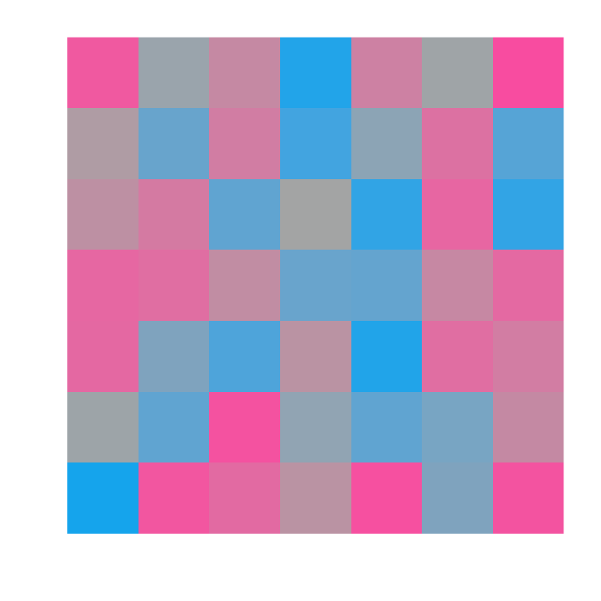
2. Measure multivoxel patterns with fMRI
Notes:
As they’re doing this task, being exposed to one of these accents, we’re measuring multi-voxel patterns of activity that are evoked by each of these three critical stimuli

Slide 52
3. Compare within- vs. between-category pattern similarity
?
Notes:
We want to see if representations of these categories changes with experience. The way we do this is to look at how the 20ms VOT pattern shifts. We’re gonna measure how similar it is to the 0ms and 40ms patterns

Slide 53
3. Compare within- vs. between-category pattern similarity
Between
Within
Low VOT
High VOT
Within
Between
Notes:
Specifically, test whether it’s more similar to the within-category VOT, which depends on the accent. so here for the low VOT condition, …

Slide 54
8
4. Test for searchlights where
within-category pattern similarity > between
4
t = 0
Notes:
we did a searchlight analysis: shine a spherical searchlight on a small part of the brain. compute within-minus-between difference score, do a t test, and write down t value in the center voxel. move searchlight slightly, do it again. make a brain-wide information map this way.
whole brain, don’t assume any particular area
apply pretty stringent statistical criteria: permutation test to control for multiple comparisons.

Slide 55
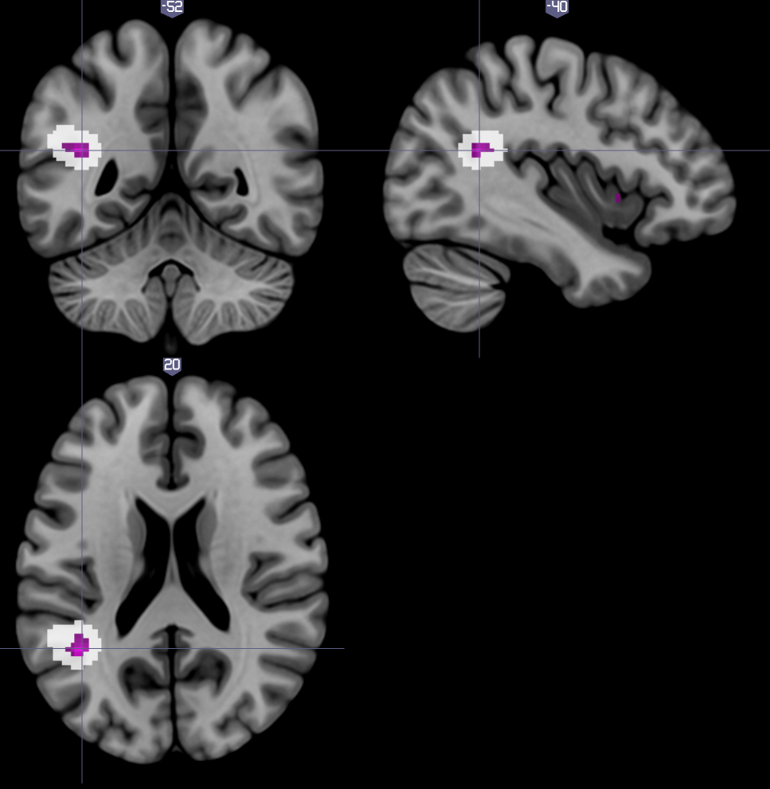
8
4. Test for searchlights where
within-category pattern similarity > between
(centers and extents)
4
t = 0
L Supramarginal Gyrus
searchlight cluster size (t > 4) p < 0.05, peak p < 0.001
by sign-flipping permutation test
Notes:
okay so what did we find? well we found one cluster that was significant by a permutation test, in the L supramarginal gyrus. here I’m showing you the searchlight centers in purple, and the extents of all the searchlights in the clusters in white.
----- Meeting Notes (8/4/16 10:41) -----
gray stuff is on the slide but don't need to talk about it. but either before or after, say "used a conservative approach didn't assume an area, results come out no matter how we use it" (probably between this and last slide)
say what area means and how it relates to other work.
linking slide before this: searchlight animation. talk over that: whole brain, don't assume a particular area.

Slide 56
Supramarginal gyrus
Categorical processing of speech. [Raizada & Poldrack, 2007]
Integrates auditory + articulatory representations (+ other senses). [Hickok & Poeppel, 2007]
Implicated in phonetic recalibration, another rapid adaptation effect that requires a teaching signal. [Killian-Hütten et al. 2011; Myers et al. 2014]
Notes:
Didn’t set out looking for a particular area, but what we found is reasonable given what we know about the neurobiology of speech recognition
implicated in perception of phonetic categories
integrates auditory and articulatory representations of phonetic categories, as well as other sensory modalities.
And, critically, it’s been implicated in another kind of rapid adaptation, phonetic recalibration or perceptual learning.

Slide 57
A unified mechanism?
Recalibration is a form of distributional learning. [Kleinschmidt & Jaeger, 2015]
Unified computational principle might correspond to unified neural mechanism in SMG.
Notes:
Despite superficial differences, recalibration is computationally well described as distributional learning.
Suggests a unified computational principle and (perhaps) unified neural mechanisms for adjusting to talker variability by distributional learning.
----- Meeting Notes (8/4/16 10:41) -----
put discussion of SMG here??
prior work finds frontal stuff too. we don't find it as robustly. different task! it's a interesting point.

Slide 58
Wrapping up
Good inference requires accurate predictions
Good predictions require adaptation (when distributions change)
Adaptation is inference (at a higher level)
...so adaptation requires good predictions (at a higher level)

Slide 59
Effective inference in a variable world involves prediction (errors) at many levels:
About stimuli (cues)
About distributions (accents)
About contexts (type of talker)

